Slide 1
5.4
Counters

Slide 2

Counters
Counter: a variable that is incremented or decremented each time a loop repeats
Can be used to control execution of the loop (also known as the loop control variable)
Must be initialized before entering loop

Slide 3
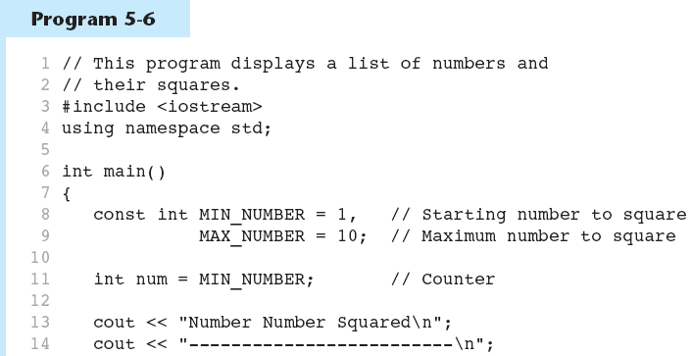
A Counter Variable Controls the Loop in Program 5-6
Continued…

Slide 4
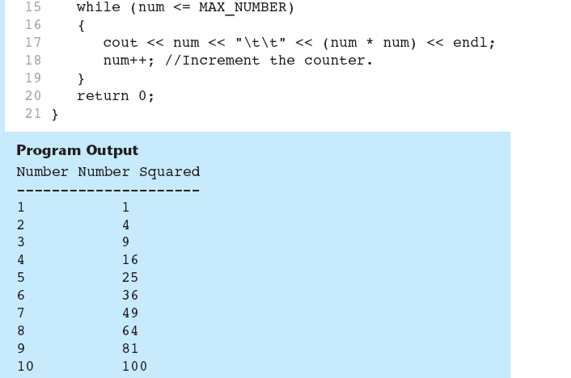
A Counter Variable Controls the Loop in Program 5-6

Slide 5
5.5
The do-while Loop

Slide 6
The do-while Loop
do-while: a posttest loop – execute the loop, then test the expression
General Format:
  do
  statement; // or block in { }
  while (expression);
Note that a semicolon is required after (expression)

Slide 7
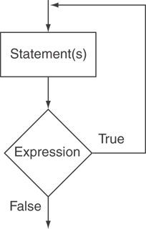
The Logic of a do-while Loop

Slide 8
An Example do-while Loop
int x = 1;
do
{
cout << x << endl;
} while(x < 0);
Although the test expression is false, this loop will execute one time because do-while is a posttest loop.

Slide 9
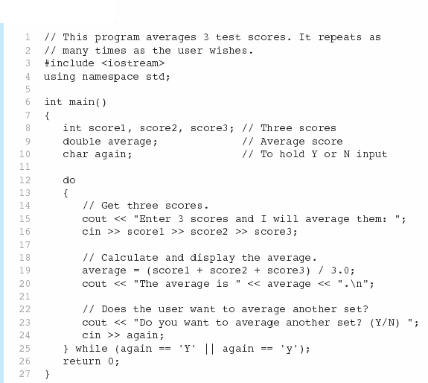

A do-while Loop in Program 5-7
Continued…

Slide 10
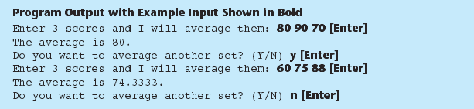
A do-while Loop in Program 5-7

Slide 11
do-while Loop Notes
Loop always executes at least once
Execution continues as long as expression is true, stops repetition when expression becomes false
Useful in menu-driven programs to bring user back to menu to make another choice (see Program 5-8 on pages 245-246)

Slide 12
5.7
Keeping a Running Total

Slide 13
Keeping a Running Total
running total: accumulated sum of numbers from each repetition of loop
accumulator: variable that holds running total
  int sum=0, num=1; // sum is the
  while (num <= 10) // accumulator
  { sum += num;
  num++;
  }
  cout << "Sum of numbers 1 – 10 is"
  << sum << endl;

Slide 14
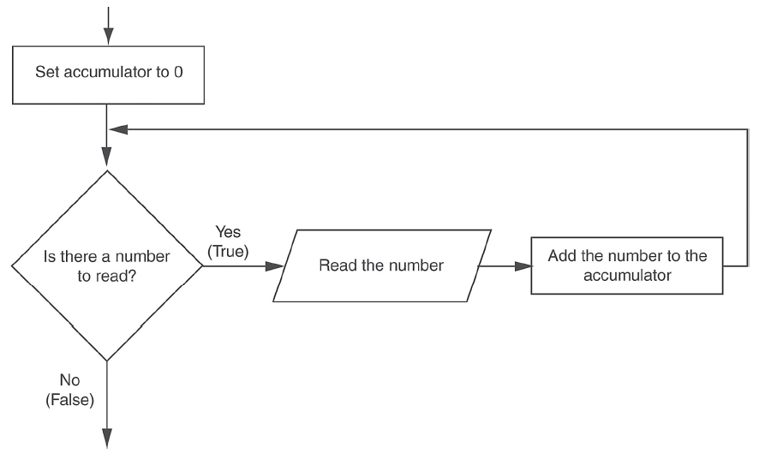
Logic for Keeping a Running Total

Slide 15

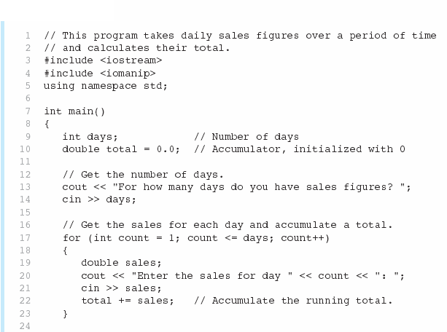
A Running Total in Program 5-12
Continued…

Slide 16
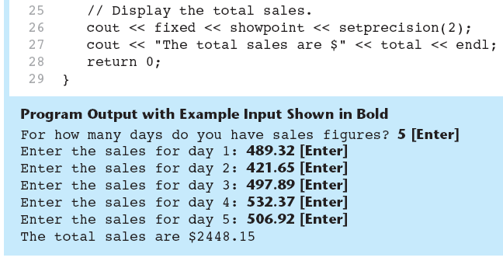
A Running Total in Program 5-12

